Slide 1
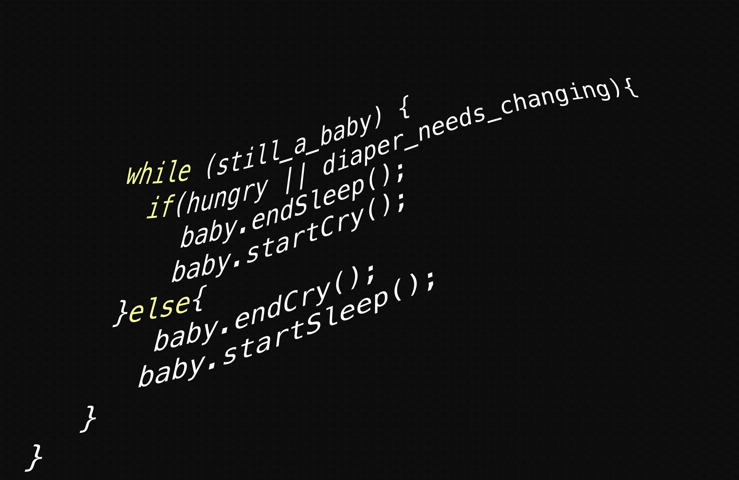
Node JS

Slide 2
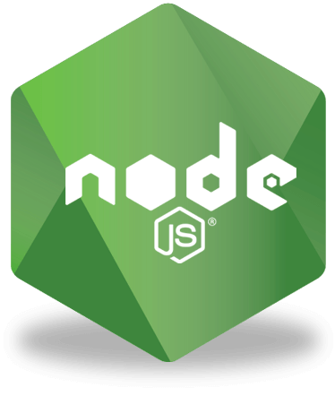
So, what’s Node JS exactly?
A JavaScript runtime built on chrome’s JavaScript engine
An open-sourced cross platform runtime environment for developing server-side and networking applications
This Photo by Unknown Author is licensed under CC BY-SA-NC

Slide 3
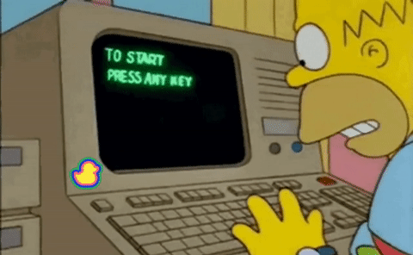
What is it used for?
Server-sided programming
Scalable network applications
Real time applications (known as RTAs)

Slide 4

Features of Node JS
Asynchronous and Event Driven
No buffering
Single threaded but highly scalable
JavaScript modules
Free

Slide 5
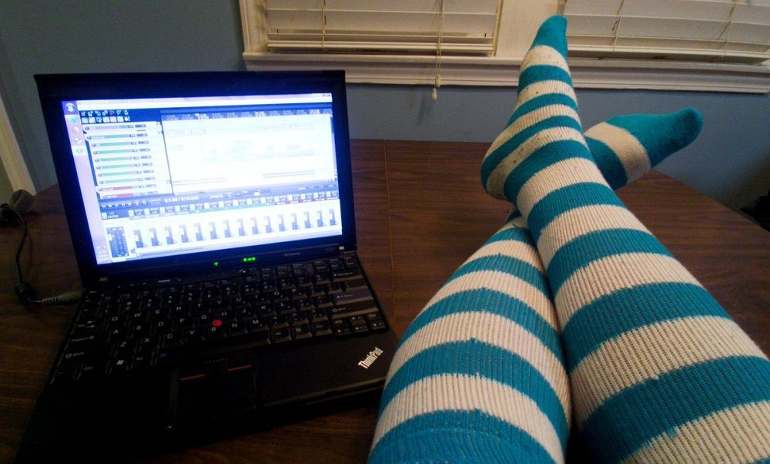
Who uses Node JS?
Companies such as: Netflix, GoDaddy, Trello, NASA, Walmart, Uber, Twitter, eBay, Paypal, LinkedIn
Many programmers (I don’t know about)
Mr. Smith’s 2021-2022 class
You

Slide 6
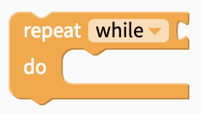
Node.js REPL
Abbreviation for read-eval-print loop
R – Reads input from the user
E – evaluates the user’s input
P – prints out the evaultion to the console
L – Loops (After the states are finished REPL loops through these states repeatedly)

Slide 7
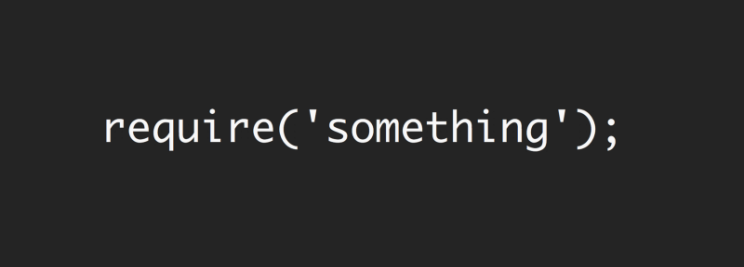
Node.js Modules
Modules are the same as JavaScript libraries
A set of functions you want to include in your application
Nodejs also have built in modules you can use without installation, a commonly used one is HTTP.
To include a module, use the require() function with the name of the module.

Slide 8
Node.js file system module
allows you to work with the file system on your computer
EX. Fs = require(‘fs’);
Commonly used to create, read, update, delete and rename files.

Slide 9
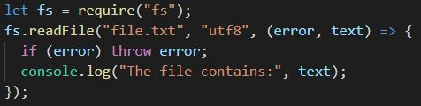
Read files
fs.readFile(filename, encoding, callback_function) is an inbuilt method to read the file.
Filename: holds the name of the file to read
Encoding: (Default is “utf8”) holds the encoding of the file.
Callback function: A call back function called after reading the file, usually takes two parameters err and data.
Err if any errors occurs. Data containing the contents of the file.

Slide 10
Node.js URL module
Splits up a web address into human readable parts
Var url = require(‘url’);
Help with making file servers

